Slide 1

Detection and Prevention of Security attacks in VANETs
Team Guide
Chaitanya N.S.V: 1BM16CS053 Dr. Nandhini Vineeth
Naveen R: 1BM16CS055 Assistant Professor
Nikhil Srinivas: 1BM16CS058
Department of Computer Science and Engineering
BMS College of Engineering, Basavanagudi, Bangalore

Slide 2

OUTLINE
Problem Statement
High level Design
Detailed Design
Implementation
Results/Snapshots of the output
Conclusion and Future Enhancements
Papers published/Communicated
References

Slide 3
PROBLEM STATEMENT
With the advancement in vehicular communications, the attacks have also increased, and such architecture is still exposed to many weaknesses which led to numerous security threats that must be addressed before VANET technology is practically and safely adopted.
One of the critical challenges faced by vehicular communication currently is the attack on the data transmission in many ways like DDoS and Sybil attack. Our work address these attacks done on the data transmitted among vehicles in VANET.

Slide 4
METHODOLOGIES USED
To uniquely identify a vehicle we are going to use the Vehicle Identification Number(VIN) since it is emitted once the vehicle is produced, and can never be changed unlike license plates for example
We now need to ensure that the VIN is really coming from the vehicle it claims. For that purpose we decided to use digital signatures, which not only solves the problem of authentication but also message integrity and non-repudiation of the sender.
To accomplish this we decided to attach a timestamp to every message, dropping messages with a timestamp above a certain threshold when compared to the current time.

Slide 5
METHODOLOGIES USED
Regarding data trust, we store previous information to detect this flawed data, reporting it to the RSU’s which will revoke the certificate of the problematic vehicle after a minimum threshold of reports (low but not low enough so an attacker is able to revoke a legitimate user certificate) have been received.
Being a critical system we have to ensure high availability of the system. For that we intend to detect if a user is sending messages too frequently at the communication unit level.

Slide 6
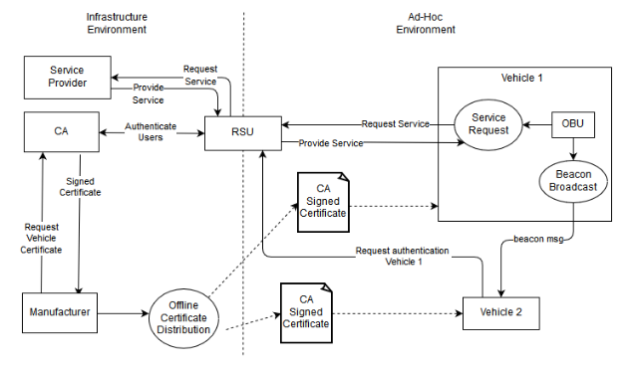
Detailed Design

Slide 7
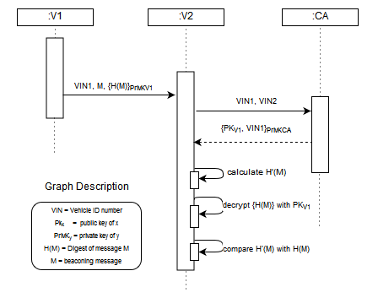
Message Exchange

Slide 8

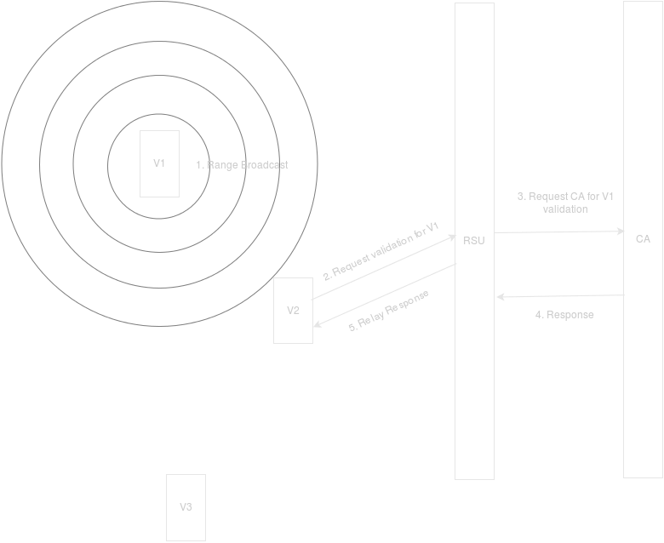
Beacon Protocol

Slide 9
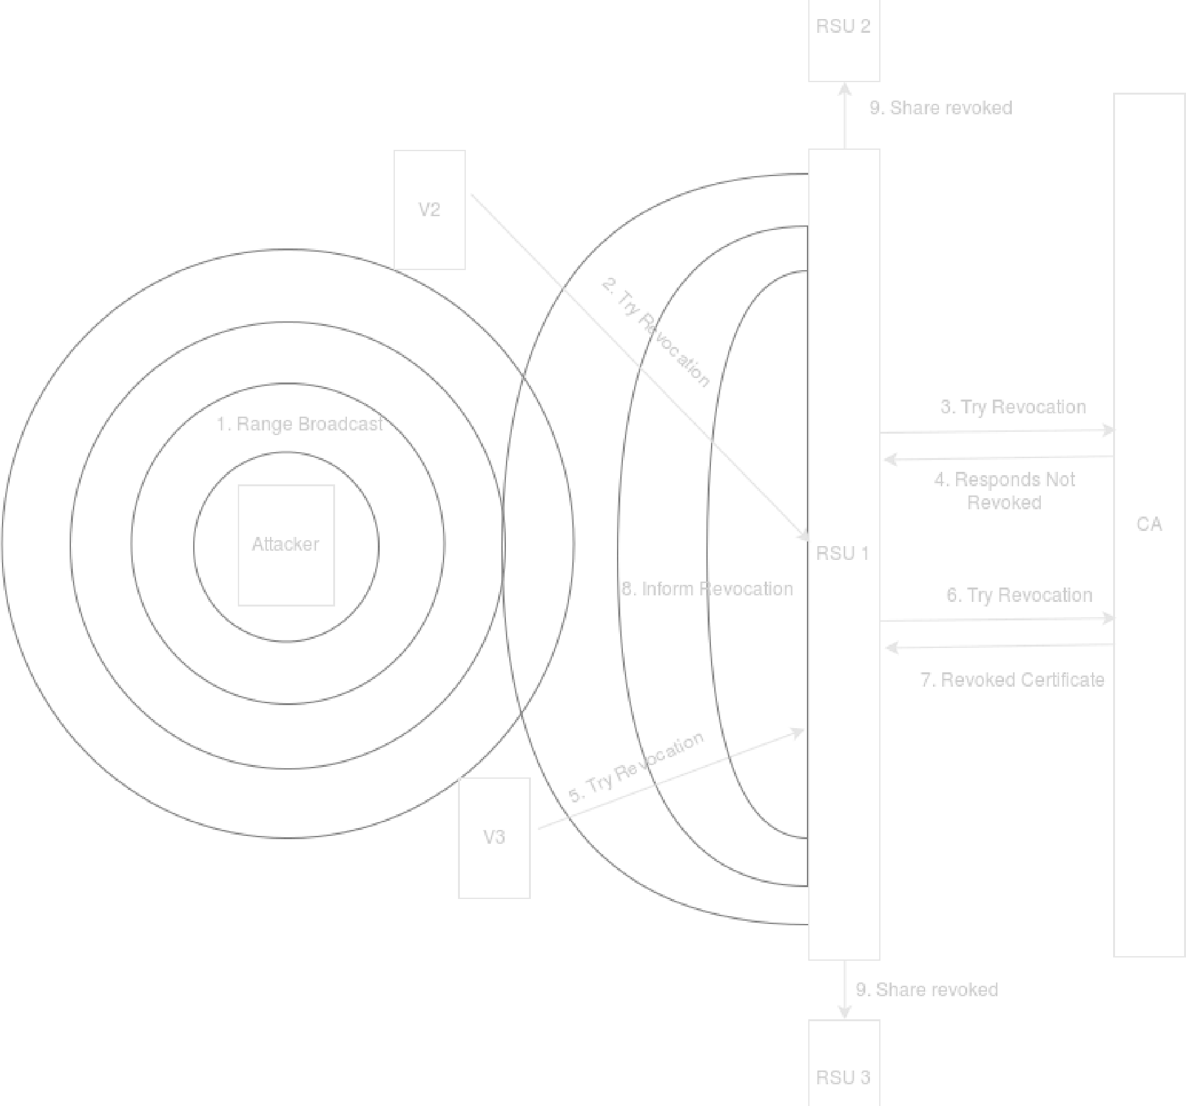
Revoke Certificate Protocol

Slide 10
Implementation
Implemented a system which detects and prevents the various security attacks in VANETs by using the Java Library’s/APIs including Java AWT, Java Security for generating certificates and handling the Asymmetric keys, Java Cryptography for all the cryptographic applications, JNetPcap for the simulation of the network traffic and Wireshark for development and testing purpose.
We propose a system that comprises of:
Implementing VANET simulation environment.
Implementing RSU and vehicle nodes.
Generated certificates for RSU and Vehicle nodes.
Detection and prevention of DDoS attacks and sybil attacks.
Improving reliability of DDoS and Sybil attack algorithm.
Improving privacy and authentication of message.
Detecting and ignoring reply attacks.

Slide 11
Implementation
We propose a system that comprises of: VEHICLE
Creating multiple vehicular nodes as actors.
Assigning these vehicle nodes certificates.
Adding these nodes in vehicle network ie. the physical architecture.
Adding the nodes in remote vehicle network ie. the virtual architecture.
Creating attacker nodes such as Bad position vehicle. This is the sybil attacker node.
Using waypoints to create a path and update velocity for the vehicles.
Creating time delays if two vehicles are in danger or close vicinity.
Checking if a vehicles certificate is valid.
Connecting to the closest RSU.

Slide 12
Implementation
We propose a system that comprises of: RSU
Creating RSU units by setting a defined range and giving each RSU unit a defined range so that it covers all the simulated area.
Creating the Revoked cache so as to enable checking of already revoked vehicle certificates to make the process of elimination faster.
Similar to the vehicle nodes the RSU nodes are also added to the RSU Remote service.
RSU nodes are added to the vehicle network .
These nodes are used to authenticate the vehicle nodes which sent the message.

Slide 13
Sybil Attack
Sybil attacks are vehicles sending falsified information to other vehicles or RSU units.
These attacks result in major damage to the vehicles.
To detect these attacks the position and the velocity is required.
If the vehicle nodes are giving false location , the node is detected as a sybil attack as the position and the velocity does not account to its previous location.

Slide 14
DDOS Attack
DDOS attacks are those which flood the user with unwanted messages in a short interval of time
These attacks can be detected by checking the rate of the message flow to the user.
If the rate of the messages is more than a predefined threshold then it is detected as DDOS attack.

Slide 15
Replay Attack
This attacker usually sends a message then after a brief interval sends the same message again.
These messages are directed towards one node at any given time.
The nodes detects if any vehicle is sending a repeated message in a given threshold of time.
Then it removes this node from the vehicle network.
We start again by launching the CA, the simulated Ad-Hoc environment and the RSUs.
It's possible to see the attacker (vehicle terminal on the right) generating messages with “late” timestamps ( these are actually gathered messages replayed
again ).
On the left the normal vehicle ignores these messages since they aren’t fresh.

Slide 16
Bad Certificate Attack
We start again by launching the CA, the simulated Ad-Hoc environment and the RSUs.
The attacker (terminal below) contains a certificate signed by another entity other than the CA recognized by all the other vehicles and consequently they report this vehicle.
The CA (terminal in the top middle) revokes the certificate (for demo purposes the revocation threshold is after 2 attempts, from individual vehicles). The vehicles themselves never actually realize he’s revoked since they first check if it's signed by the CA.
The attacker also complains from invalid CA signatures on beacons since other vehicles don't use his wrong CA and he also tries to revoke them, however the RSU detects his invalid attempt and refuses his request since his certificate is invalid

Slide 17
Bad Signature Attack
This is a simple case where the attacker (terminal on the right) generates bad signatures on his messages.
These signatures are detected by the vehicle on the left and the message is ignored.
If vehicle identification number claims from the deferent vehicle which creates problem during the authentication.
This method solves the authentication, message integration and Non-repudiation of the sender.

Slide 18

Results/Snapshots of the output
Simulation Environment

Slide 19
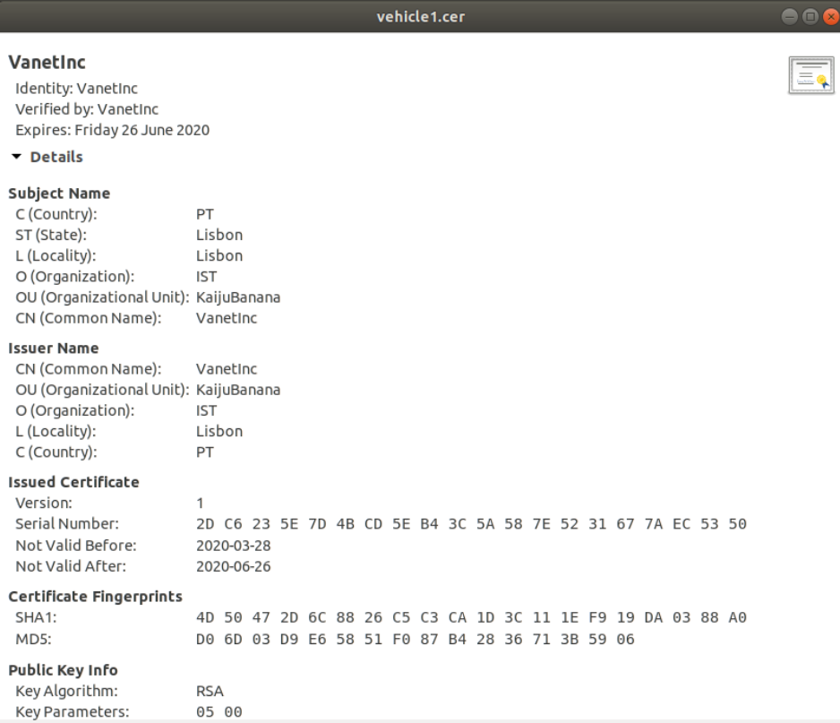
Generating Certificate

Slide 20
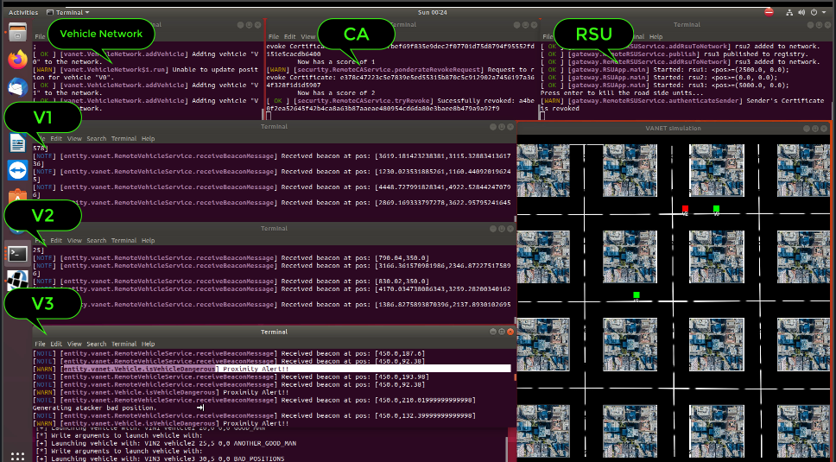
Sybil Attacks

Slide 21
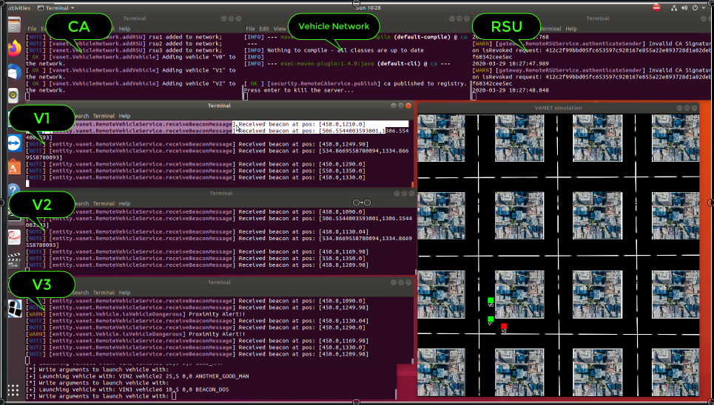
DDOS Attack

Slide 22
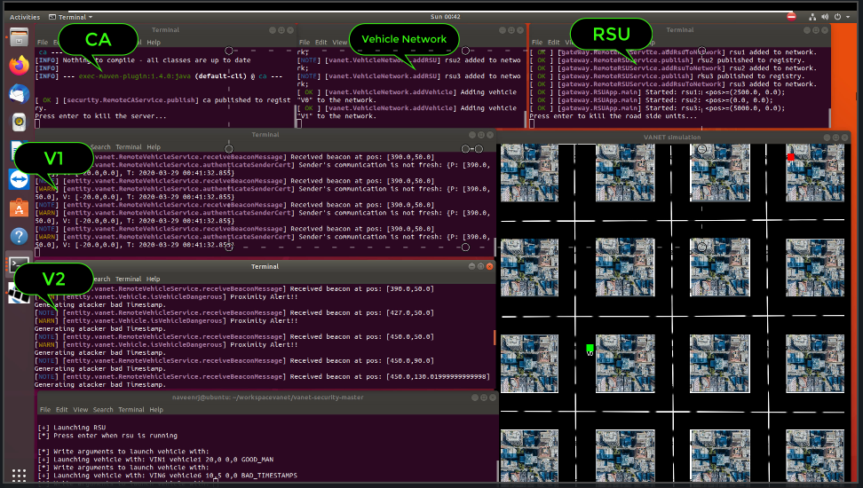
Replay Attack

Slide 23
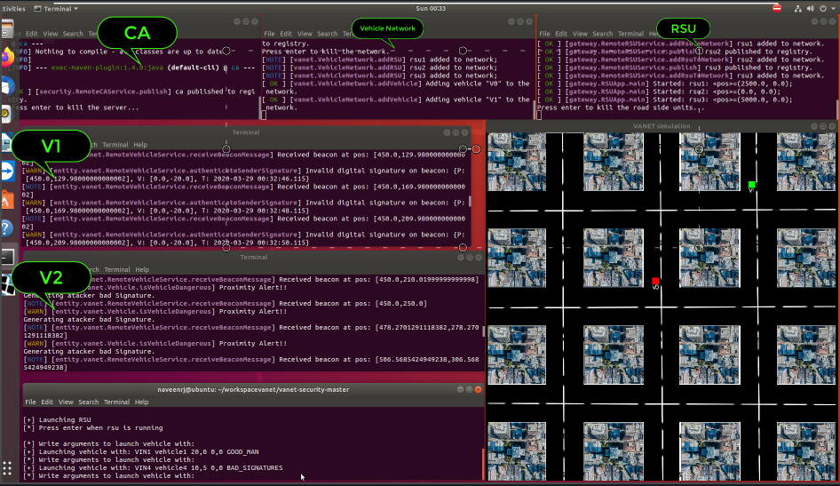
Bad Certificate Attack

Slide 24
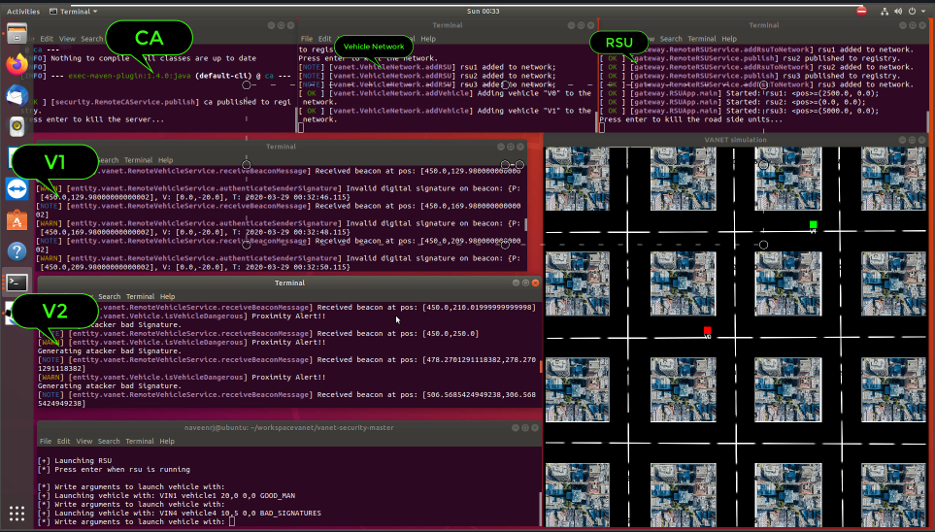
Bad Signature Attack

Slide 25
Conclusion and Future Enhancements
In this report, the implemented system which detects and prevents the major security attacks in VANET.
The nodes which are responsible for the attacking the network are detected to prevent the sybil attack on the basis of the previous record in the RSU, both irrelevant and genuine packets are detected by this system.
The system detects and revokes the bad certificate and signature of the vehicle. Finally calculating the frequency and velocity of the vehicle system detects and prevents the DDOS attacks in VANETs.
Other performance parameters also show effective difference in their values which proves that the proposed algorithm is an improved version of existing packet detection algorithms.

Slide 26
Conclusion and Future Enhancements
All recent studies in this field focus more on DDoS and other security attacks, such as how to detect and prevent them, from the security point of view of VANET.
In addition, the report provides various security solutions for various attacks in VANETs using machine learning capable of detecting patterns in attacks.
As part of our future work, we create an environment by using simulation tools that help us produce datasets that are greater than general and public datasets by using VCC (Vehicular Cloud Computing).
By using this dataset, we can create a real-time context that lets us detect threats. We put forward to provide a solution for detecting and prevent Security attacks in VANET along with its prevention rate, detection rate and its own design.

Slide 27
Papers published/Communicated
Author Names: Naveen R, N.S.V Chaitanya, Nikhil Srinivas M, Dr. Nandhini Vineeth
Paper Title: Survey on Detection and Avoidance of Security Attacks in Vehicular Adhoc Networks.
Name of the Conference or Journal:
The Paper had been accepted by:
Eleventh international conference on recent trends in information telecommunication and computing -ITC 2020 which was held on Feb 28-29, 2020 in Bangalore, India.

Slide 28
References
Nice Mathew, V. Uma, “VANET Security -Analysis and survey,” International Conference on Control, Power, Communication and Computing Technologies (ICCPCT), 2018.
Jeevitha R, N Sudha Bhuvaneswari, “Malicious node detection in VANET Session Hijacking Attack,” ICECCT.2019.8869452 IEEE 2019.
Mohammad Syfullah, Joanne Mun-Yee Lim, “Data Broadcasting on Cloud-VANET for IEEE 802.11p and LTE Hybrid VANET Architectures,” 3rd IEEE International Conference on "Computational Intelligence and Communication Technology" (IEEECICT 2017).
Gabriel de Biasi, Luiz F. M. Vieira, Antonio A. F. Loureiro, “Sentinel: Defence Mechanism against DDoS Flooding Attack in Software Defined Vehicular Network,” IEEE International Conference on Communiciations (ICC-2018).
Ying gao, Hongrui wu, Benjie song, Yaqia jin, Xiongwen luo,Xing zeng, “A distributed network intrusion detection system for ddos detection in vanet,” Proceedings of the Second International Conference on Computing Methodologies and Communication (ICCMC 2019) IEEE Conference Record # 42656; IEEE Xplore ISBN:978-1-5386-3452-3.
Charu Guleria, Harsh Kumar Verma. “Improved Detection and Mitigation of DDoS Attack in Vehicular ad hoc Network,” 4th International Conference on Computing Communication and Automation (ICCCA) 2018.
Sushil Kumar, Kulwinder Singh Mann, “Prevention of DoS Attacks by Detection of Multiple Malicious Nodes in VANETs,” 2019 International Conference on Automation, Computational and Technology Management (ICACTM) Amity University 2019 IEEE.
Yutong Liu, Kai Shi “Analysis of Packet Loss Characteristics in VANETs” 4th International Conference on Computing Communication and Automation (ICCCA) 2018).
Roshini T V, “An Efficient Privacy Preserving Scheduling in VANET using NS-2” ((ICETIETR-2018).

Slide 29
References
D. Kiruba Sandou, N.Jothy, K.Jayanthi, “Secured Routing in VANETs Using Lightweight Authentication and Key Agreement Protocol” Proceedings of the Second International Conference on Computing Methodologies and Communication (ICCMC 2018) IEEE Conference Record # 42656; IEEE Xplore ISBN:978-1-5386-3452-3.
Salman Ali Syed, B.V.V.S Prasad, “Merged technique to prevent SYBIL Attacks in VANETs,” 3rd IEEE International Conference on "Computational Intelligence and Communication Technology" (IEEE-CICT 2019).
Zhang, X., Li, R., & Cui, B. (2018), “A security architecture of VANET based on blockchain and mobile edge computing”. 2018 1st IEEE International Conference on Hot Information-Centric Networking (HotICN).
Ala Al-Fuqaha, “Severity-Based Prioritized Processing of Packets with Application in VANETs” 3rd IEEE International Conference on "Computational Intelligence and Communication Technology" (IEEE-CICT 2017).
A. Asline Celes and N. Edna Elizabeth, “Verification Based Authentication Scheme for Bogus Attacks in VANETs for Secure Communication” 4th International Conference on Computing Communication and Automation (ICCCA) 2018
Marwane Ayaida, Nadhir Message, Geoffrey Wilhelm, “A Novel Sybil Attack Detection Mechanism for C-ITS,” 4th International Conference on Computing Communication and Automation (ICCCA) 2019.
Harsha Vardan Maddiboyina, “Fuzzy Logic Based VANETS: A Review on Smart Transportation System”, 3rd IEEE International Conference on "Computational Intelligence and Communication Technology" (IEEE-CICT 2019)
Ahmed Yasser, “VANET routing protocol for V2V implementation: A suitable solution for developing countries” Second International Conference on Communiciation and Computational Technologies 2018.
P Sailaja, Banoth Ravi. Jaisingh, “Performance Analysis of AODV and EAODV Routing Protocol Under Congestion Control in VANET”, 2018 Second International Conference on Communiciation and Computational Technologies.

Slide 30
THANK YOU

